Slide 1
Lets manage our waste on our own way
Road to make a Green future…

Slide 2
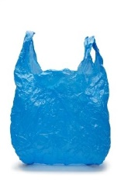

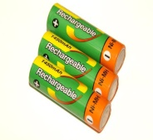
SYSTEMATIC GARBAGE DUMPING….
Cooking disposal
Vegetable waste
Left overs
Plastic and polythene
Plastic containers
Shopping bags(polythene)
Electronic waste
Batteries
Broken electronic appliances

Slide 3
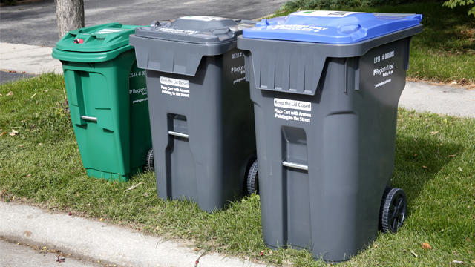
Home Recycling
Using different dumping baskets domestically would help to reduce waste dispersing within the country.
This would help us indirectly to minimize various number of problems such as spread of diseases and various other in direct benefits for the citizens of our country.

Slide 4
Adapting of modern technology for waste collection…
Using of modern garbage collecting eqiupments (garbage truck) and also using of efficient and effective garbage collectors to collect garbage and dispose them to proper places.
Enacting rules and regulations and law enforcement for proper disposal and collection of garbage.

Slide 5
Use of environmental friendly items..
Unfriendly polythene and bags which are harmful to the environment should be minimized in order to minimize the environmental crisis prevailing in our country.
It’s an equal responsibility of every citizen to use eco friendly bags (paper bags) in order to minimize the polythene use which is deadly.

Slide 6
Bio gas
Garbage collected should be recycled and managed properly, we should use effective ways to manage waste. For example,
Bio gas is an efficient way to manage in to recycle waste. Bio gas is helpful to produce electricity, fuel, and in cookery as a flame.

